Slide 1
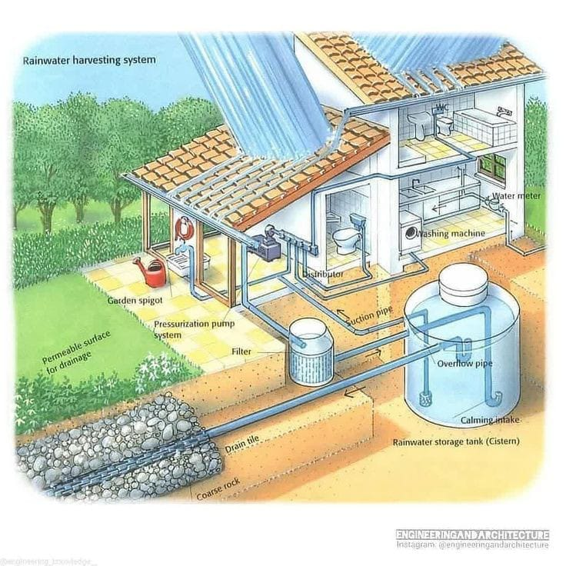
Rain Water Harvesting
DTIL Guidance:
Dr. Ajit Muzumdar Sir
Prof. Pravin Chokakkar Sir

Slide 2
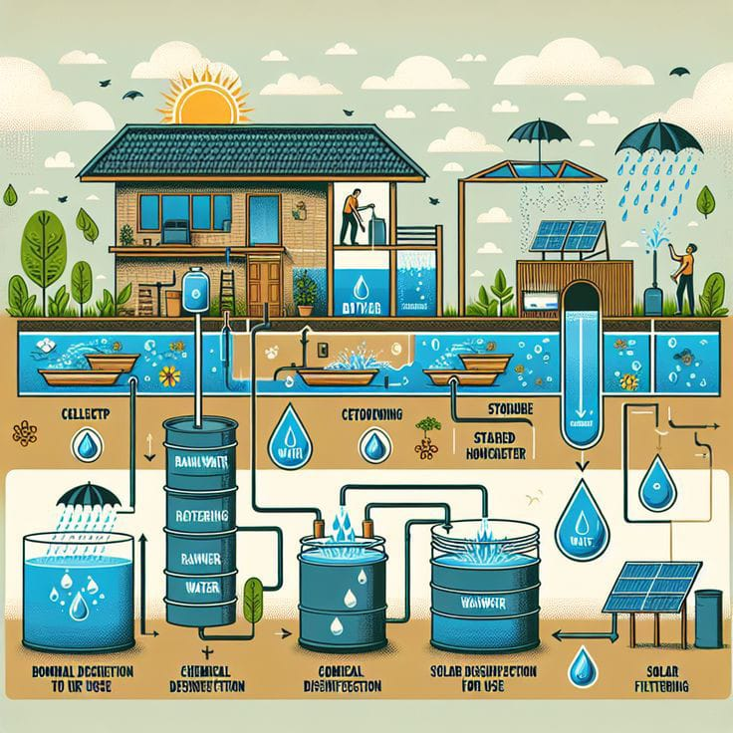
Team Unbreakable Group No:16
Member Names:
Sanjivani Mogare-2124UCSF1103
Sanika Kadam-2124UCSF1112
Harshal Navarkar-2124UCSM1015
Tejas Khalkar-2124UCSM1083
Omraje Bhalsing-2124UCSM1033
Dhanashree Nehe-2124UCSF1127

Slide 3
Problem Statement:
In urban and rural areas, rainwater harvesting systems are becoming increasingly important as a sustainable way to conserve water, reduce dependency on municipal water supplies, and mitigate the effects of water scarcity. However, one of the biggest challenges faced by these systems is proper management of the tank's water capacity and How can we avoid water by getting contaminated?
Relevance of the problem statement for social causes:
Urban and Rural Water Scarcity: Both urban and rural areas often face water scarcity issues due to over-extraction of groundwater, irregular rainfall.
Preventing Water Contamination: Contaminated water is a major cause of waterborne diseases, particularly in rural areas where access to clean water is limited.

Slide 4
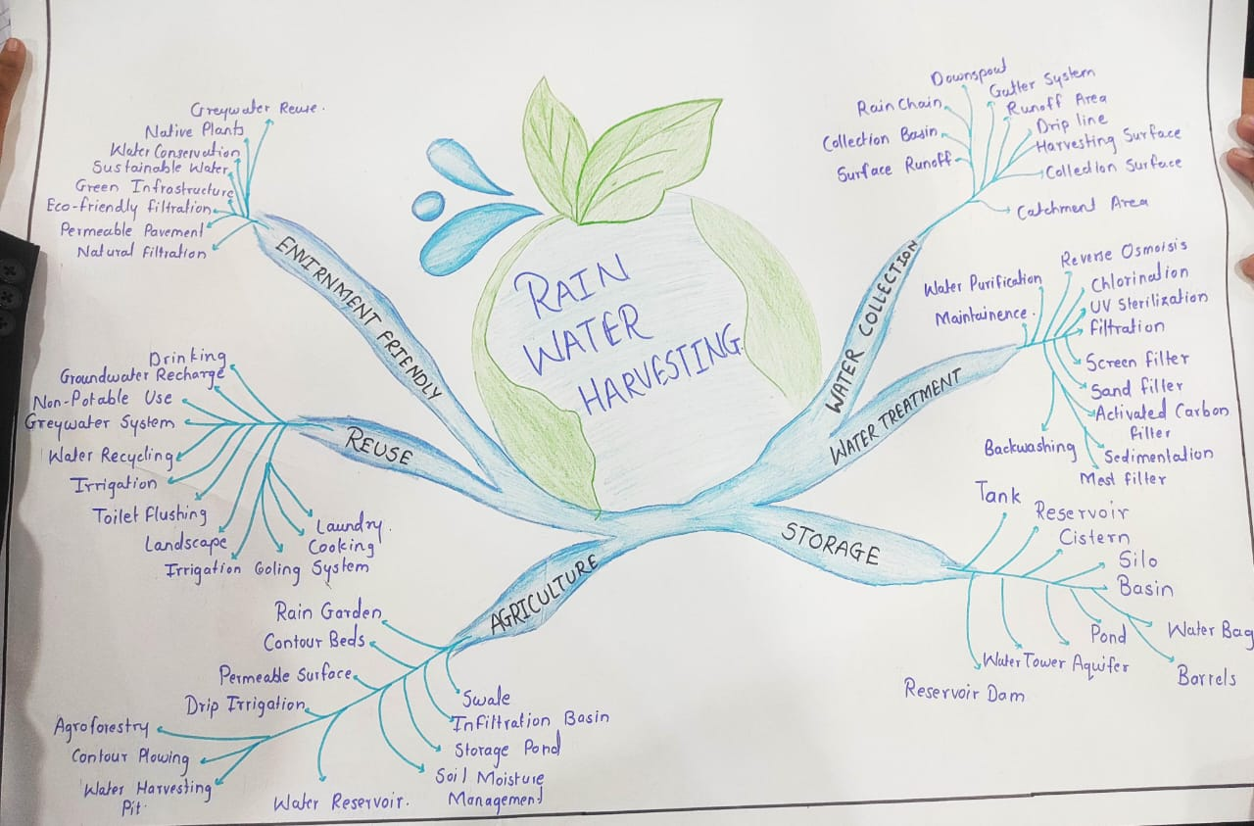
Mind Map: A Mind map is a simple visual tool that helps you organize ideas around a central topic.

Slide 5
Persona 1:Farmer
Motivation:
1.Ravi is interested in making profit ,this motivates he to learn and to make decision how to maintain.
2.Improve the quality life.
Background:
1.Ravi is in poor family.
2.He is primary educated.
3.He has medium sized plot of land.
4.He work hard.
5.He lives whole family.
Doubts:
If the field is not surrounded by compound, people will steal the crops from the field.
Challenges faced:
1.Ravi facing the problem of water storing.
2.Irrigation problem.
3.Pests and diseases.
4.Soil erosion.
Aspirations:
1.Working towards achieving financial security and profitability.
2.Aspiring to learn continuously about new farming techniques and share this knowledge with other farmer.
Story: Ravi is a farmer from a poor family. He is primary educated. He work hard. He faced the challenges like soil erosion, water storing, irrigation. He is full motivated about the farming. He learn continuously new things, and make a farm greeny.

Slide 6
Persona 2:Urban Area People
Background:
1.Sanju is in middle class family.
2.He is higher educated.
3. He has big plot of land.
4.He lives with is family
He, wife, son.
Motivation:
1.Access to Fresh, Healthy Food.
2.Educational and Skill Development.
Doubts:
1.Soil Quality and Contamination.
2.Pests and Disease Management.
Challenges faced:
Limited Space for Farming.
High Cost of Land.
Soil Quality and Pollution.
Water Scarcity and Management.
Aspiration:
1.Self-Sufficiency in Food Production.
2.Starting an Urban Farming Business.
Story: Sanju is in middle class family. He is higher educated. He has a big plot of land. He faced the challenges like soil quality, limited space, pollution. He is motivated to learn new technique. His aspiration is is started urban farming business.

Slide 7
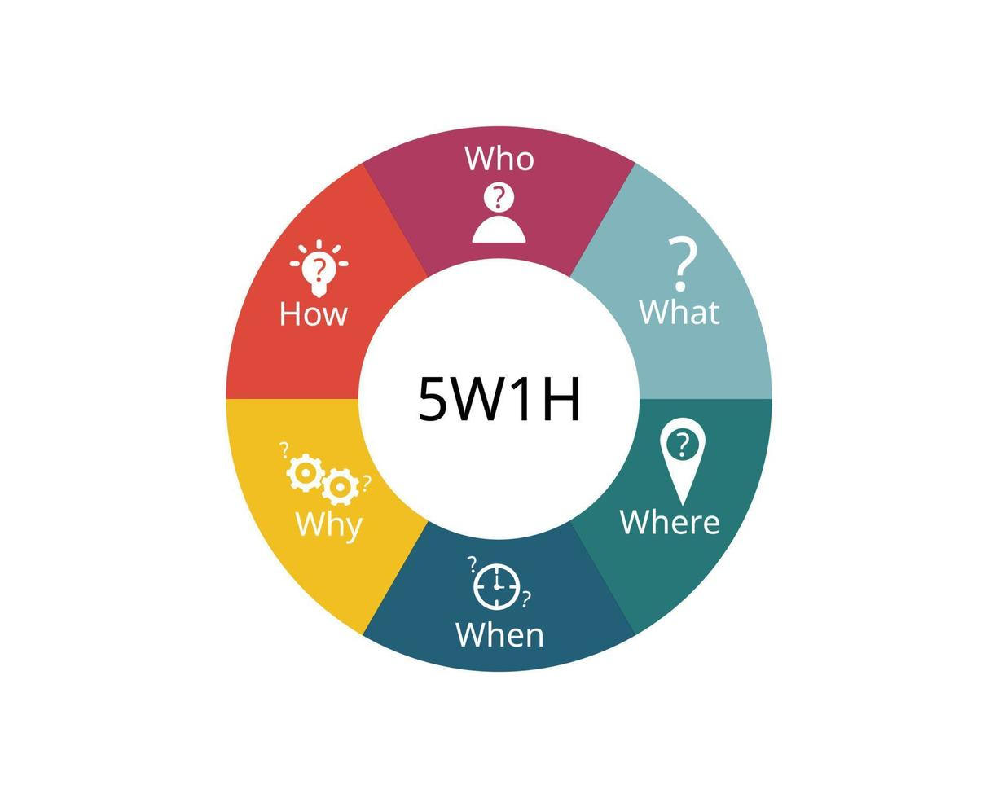
5W1H Matrix (Who, What, Where, When, Why, How) according to mind map
Who:
Who benefits from rainwater harvesting?
Communities in need of water conservation.
Agricultural sectors, urban planners, and environmental
organizations.
What:
What is rainwater harvesting?
The process of collecting and storing rainwater for reuse in various applications like irrigation, drinking, groundwater recharge, and agriculture.

Slide 8
Where: Where is rainwater harvested? Water collection: Catchment areas like rooftops, surface runoff, ponds, and natural collection points. Storage: Reservoirs, cisterns, ponds, and tanks. When: When should rainwater harvesting systems be used? In rural or underserved urban areas where access to municipal water is limited

Slide 9
Why: Why is rainwater harvesting important? It helps conserve water, supports sustainable agriculture, reduces water shortages, and recharges groundwater. How: How is rainwater collected and used? Water Collection: Via gutters, pipes, and surfaces that lead water to storage. Storage: In tanks, reservoirs, and cisterns. Treatment: Filteration.

Slide 10
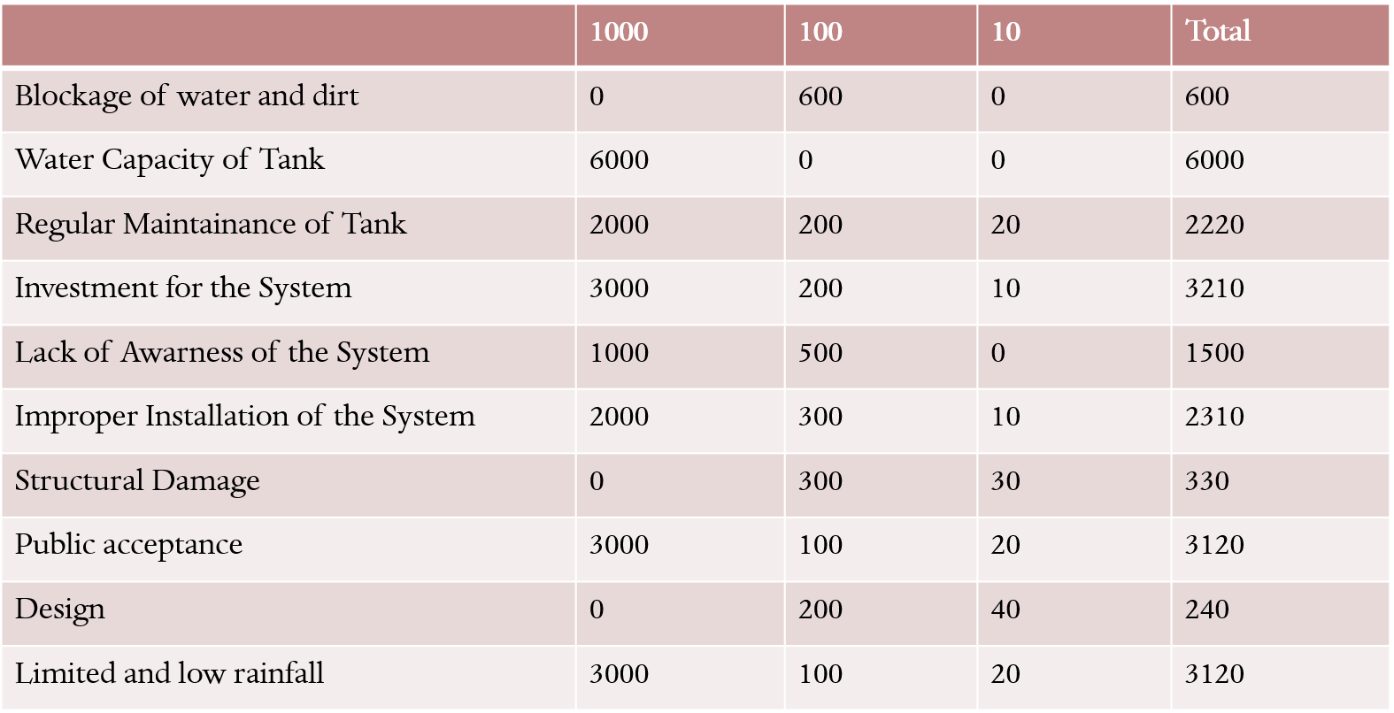
Theory of Prioritization:

Slide 11
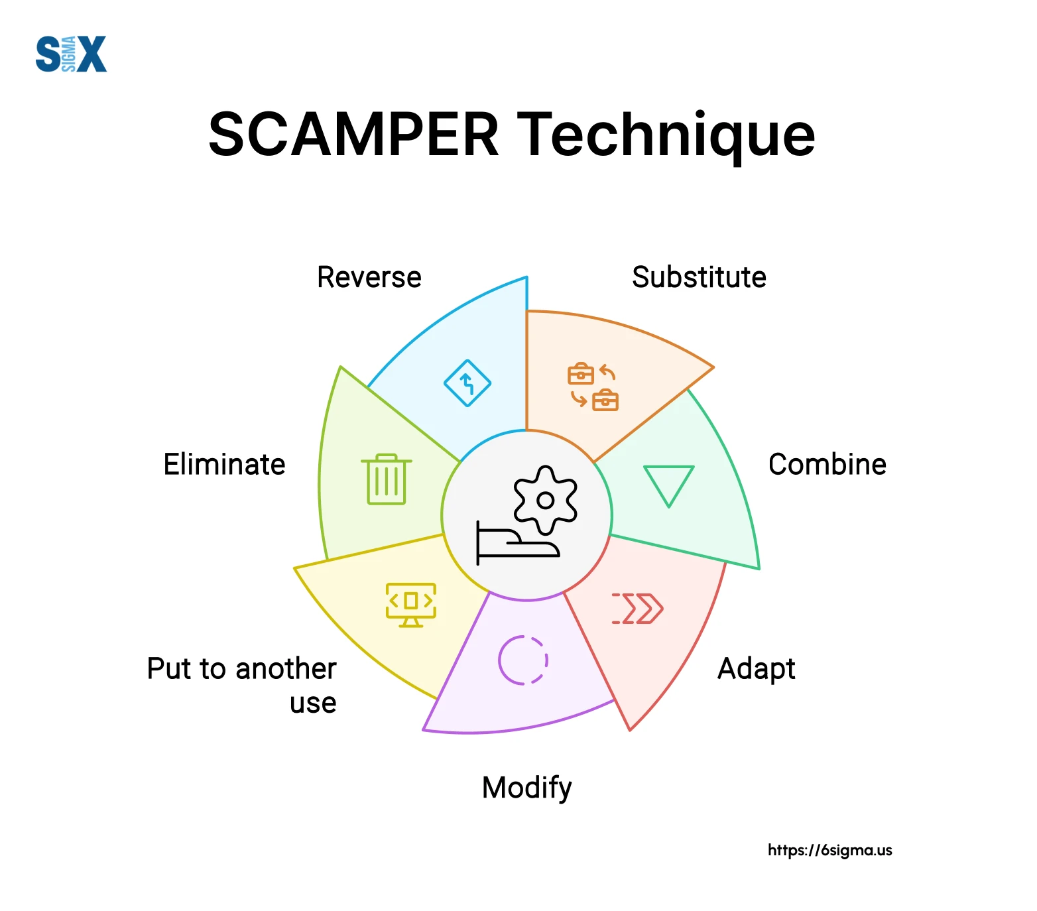
SCAMPER:
SCAMPER as a teaching strategy helps the students to analyze the knowledge in its creative form and helps the teacher to make teaching creative and interesting.
S-Substitute
C-Combine
A-Adopt
M-Modify
P-Put to another use
E-Eliminate
R-Reverse

Slide 12
Detailed about SCAMPER:
SUBSTITUTE- We can use more sustainable materials for rainwater harvesting components (e.g., biodegradable filters, recycled plastic pipes).
COMBINE- Combine individual household systems with community-based storage facilities, increasing the scale of rainwater harvesting.
ADOPT- Use green roofs that not only collect rainwater but also help with insulation and urban heat island reduction.
MODIFY-Increase the storage capacity of rainwater harvesting systems in urban areas to meet growing water demands and added sensors to the tank..
PUT TO ANOTHER USE-It is not valid only during rainy season we can use in our daily life also , like non-drinking purposes like cleaning, cooling systems, or industrial uses etc.
ELIMINATE- Simplify the cleaning, maintenance, and monitoring processes for rainwater harvesting systems to reduce long-term costs and effort.
REVERSE- Simplify the cleaning, maintenance, and monitoring processes for rainwater harvesting systems to reduce long-term costs and effort.

Slide 13
SELECTED TECHNIQUES FROM SCAMPER
MODIFY- Increase the storage capacity of rainwater harvesting systems in urban areas to meet growing water demands and added sensors to the tank.
PUT TO ANOTHER USE- It is not valid only during rainy season we can use in our daily life also , like non-drinking purposes like cleaning, cooling systems, or industrial uses etc.

Slide 14



JOURNEYMAP:1 Farmer
EVENT 1-Installation of app.
EVENT 2- For login and sign up.
EVENT 3- When he see all the feature of app.
EVENT 4- He understood all the feature.
EVENT 5- He start to implement in his home.
EVENT 6- Receiving alerts for water levels.
EVENT 7- He get the water quality like PH.
EVENT 8-All the feature are useful for him.
EVENT 9- Customer support.

Slide 15
JOURNEYMAP: 2 Urban people
EVENT 1-Downloading the App.
EVENT 2- Account Creation .
EVENT 3- Setting the rain water harvesting.
EVENT 4-Learning the Feature.
EVENT 5-Implementing the feature.
EVENT 6-Getting alerts & notification on time .
EVENT 7: Water level of tank.
EVENT 8-Customer Support.

Slide 16
Thank You

